Slide 1
L01 – History of software development
FIT2101: Software Engineering Process and Management
S2 2020

Slide 2
In this lecture…
About FIT2101
Software process models
History of software process models
ad hoc
waterfall
prototyping
spiral
agile

Slide 3
About FIT2101
Core unit for Software Engineering
Core unit for BInfoTech(Software Development)
Taught at Sunway and Clayton
146 students at Clayton
88 students at Sunway (Malaysia)
large majority are Engineering students (presumably Software Engineering)
Clayton: 87% BE(Hons), 7% BInfoTech, 6% other
Sunway: 50% BE(Hons), 41% BCompSci, 9% other
many BE(Hons) students are taking a double degree
Notes:
The figures for BE(Hons) include double degrees. 58 students at Clayton (and all Engineering students at Sunway) are taking BE(Hons) as a single degree. No information is available at this stage about these students’ declared major but all Engineering students take ENG1003 as part of their first year core, so all have done at least some software engineering.

Slide 4
What will you learn in FIT2101?
Designed to teach you about the organization and management of software projects
Primary objective: get Software Engineering students ready to organize themselves in their third-year and fourth-year projects
so: practical focus rather than theory
Not an in-depth course on project management!
if you want to be a project manager after graduation, Monash offers several options:
double degree with (e.g.) BCommerce
Grad Cert, Grad Dip, and Masters-level qualifications in Project Management
speak to BusEco if interested
PM courses also available from other providers
in Australia: TAFE
IEEE Computer Society has an online PM course
Notes:
According to Allocate, many of the students at Clayton are already taking a double degree in Engineering/Commerce.

Slide 5
How will you learn in FIT2101?
Lectures
primarily designed to help you understand material rather than to transmit information
lecture slides will be posted on Moodle after each lecture
if they’re not, email your lecturer
Readings
will be put on Moodle each week
examinable if Moodle says they’re compulsory
Workshop exercises
let you practice your skills
get feedback from your workshop facilitator
mostly, to be done in groups

Slide 6
How will you be assessed in FIT2101?
Project to be announced end of Week 2/start of Week 3: 60%
Inception documentation: 15%
Iteration 1: 10%
Iteration 2: 10%
Iteration 3: 15%
Individual project review: 10%
to be done in teams of 4-6
Exam: 40%
two hours
open book
can bring in any material on paper (including books, notes, etc.)
don’t care whether it’s printed or handwritten
also don’t care whether it’s bound or looseleaf
Notes:
The official policy of the Chief Examiner is that you are not allowed to do the project individually. This unit is intended to reinforce your teamwork skills, and you can’t do that in your own.
We will give you an initial outline of our requirements for the project, and then your team will have to decide on a platform and a language. You will justify your decision as part of your inception phase, and the quality of your justified decision-making will be assessed.
Full requirements are to be negotiated with your demonstrator, and should include both “basic functionality” goals and “stretch” goals.
It will be possible to pass the project even if the software doesn’t work provided you have defined a good process in your Project Management Plan and then stuck to it. Bonus marks will be available for teams who implement stretch goals provided this is done as part of a disciplined process – ad-hoc software construction and crunch-mode programming will not be rewarded!

Slide 7
Why process and management?
Aim of software engineering: develop and apply systematic methods to develop software
on time
on budget
to spec
A software process model tells you which activities should happen when
helps you build what your customer wants and make sure it’s right
Good management enables all this to happen on time and on budget
Notes:
You will often hear horror stories about managers who are demanding, arrogant, imperious, or otherwise make developers’ lives difficult. These are (usually) bad managers. Good management isn’t about ordering people around, and managers aren’t necessarily leaders – a manager should be part of the team, facilitating its actions, seeing to it that the team is adequately resourced, making sure they all know what they should be doing, and seeing to it that developers spend as much time as possible programming in a state of flow.

Slide 8
What is a process model?
Dictionary definition of process: a series of actions or steps taken in order to achieve a particular end
A process model is a model (i.e. a simplified description) of the steps you need to take to achieve your goal
it’s a “model” because we’re handwaving a lot of detail

Slide 9
A brief history of process models
L01 Part II

Slide 10
Prehistory of process models: code and fix
Development
Also known as ad-hoc software development
Nice and simple!
definitely simple, anyway…
When programming was a new discipline, this is what most people did
So, did it work?
well, what do you think?
Write code
Edit code until it meets requirements
Deliver
Legend
Development
Maintenance

Slide 11
Code-and-fix works, up to a point…
In the 1940s and 1950s…
systems were small (by today’s standards)
developers tended to be brilliant
only the very highly motivated went into the field
often people with higher degrees in mathematics or engineering
developers, clients, and end users were often the same person
fewer issues around requirements
programs often were only ever run once
little need for maintenance, configuration management, version control

Slide 12

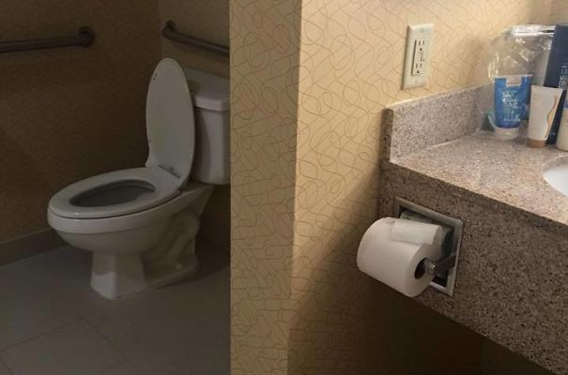
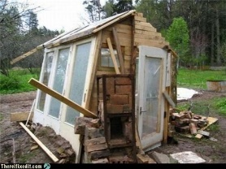
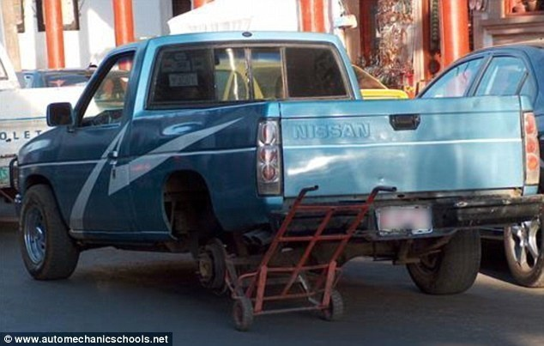
But…
Unplanned, ad-hoc fixes can lead to a system that does not work, or is lacking in security, robustness, or usability – especially if time is short.

Slide 13
The problem…
Ad-hoc processes such as code-and-fix don’t scale well
no documentation of design so hard to maintain
testing/QA unsystematic so many issues overlooked
don’t know how many cycles it’ll take to get the product working so hard to stick to budget and timeline

Slide 14
1960s: the software crisis
By the 1960s, computers were getting much more powerful
so were the programs
customers’ and users’ expectations were becoming more sophisticated
But a large majority of software projects:
shipped late (or not at all)
went catastrophically over budget
didn’t work
or all of the above!

Slide 15
1968-69: NATO conferences
“We build systems like the Wright brothers built airplanes — build the whole thing, push it off the cliff, let it crash, and start over again.”
The NATO conferences on Software Engineering had an impact still being felt today
brought the phrase software engineering into common use
leaders in the computing profession resolved to address the problems we’ve mentioned
attendees included famous computer scientists such as Edsger Dijkstra, Tony Hoare, Stanley Gill, Alan Perlis, and Peter Naur
Notes:
Edsger Dijkstra invented a number of famous algorithms, including the Dutch National Flag algorithm for efficient partitioning, the single-source shortest paths algorithm, a version of Prim’s algorithm for generating minimum spanning trees, the shunting algorithm for parsing infix expressions, and many more. He also invented the semaphore, a mechanism for guaranteeing mutual exclusion in concurrent and parallel programming.
Tony Hoare developed the Quicksort algorithm and invented the null pointer.
Stanley Gill invented the subroutine.
Alan Perlis was a key figure in the design of ALGOL, one of the most influential programming languages of all time. He was the founding editor of Communications of the ACM. He’s also the author of a famous CACM article, “Epigrams on Programming”. If you haven’t read that yet, you should; it contains a great deal of useful advice on programming.
Peter Naur modified John Backus’s metalanguage notation so that it used only standard characters, thus creating Backus-Naur Form. Students who have taken FIT2014 may remember this as a notation for describing context-free grammars. BNF and its descendent EBNF (Extended Backus-Naur Form) are still used to define syntax, even for modern languages like Go (https://golang.org/ref/spec#Notation) and Rust (https://doc.rust-lang.org/grammar.html).

Slide 16
1970: Waterfall model
Requirements
Find out what stakeholders want the product to do
Analysis
Figure out exactly what this means (create Software Requirements Specification)
Design
Determine how to build the product (create design documentation)
Implementation
Code & integrate (create working product)
Maintenance
Repair or enhance
Development
Retirement
Remove from service
Notes:
The Waterfall model was inspired by the way that projects in “physical” engineering disciplines such as civil engineering are organized. If you’re building a bridge or a skyscraper, you definitely need to design it first – and you can’t go back and change the design in any significant way once the concrete has been poured, at least not without a great deal of expense. Moreover, the clients of physical engineering projects are more likely to understand the expense involved when requirements change at the last minute.
The Waterfall model evolved over the course of the 1960s and seems to have been first documented by Winston Royce in 1970 – although he never used the word waterfall to describe it, and the paper in question was critical of the model, preferring one with prototyping and customer involvement.

Slide 17
Waterfall ideas
Development is broken up into distinct phases
These phases do not overlap, e.g. implementation cannot begin until design is complete
Each phase has a document of some sort as its output
if we consider source code as a special kind of document
Not shown: testing and quality assurance activities
in general, all documents created would go through QA before development can proceed
and of course QA might find errors…

Slide 18
A more realistic waterfall model
Requirements
Changed
Requirements
Analysis
Design
Implementation
Maintenance
Development
Retirement
Maintenance
Notes:
Let’s add some more realistic features to our waterfall model.

Slide 19
But…
This is a document-driven approach
transitions between phases are managed by the production of documentation
notably the SRS and the design documentation
if an error is found and the system needs to change, documentation needs to be kept up to date
this is very costly!
So Waterfall does not work well for projects where
errors are possible in requirements elicitation, analysis, design
requirements are hard to figure out or subject to change

Slide 20

How realistic is this?
Very few real-world projects are insulated from change
even if customers really do know what they want
business environment, regulatory environment etc. are beyond the control of developers and customers alike
hard to quarantine projects from changes in the technical environment: operating systems, libraries, network speed etc.
would you really want to promise never to apply security patches to the OS?
Not very.
Notes:
Jetpack Unicorn In Space courtesy of Mary McNamara, aged 20.

Slide 21
What does this mean for Waterfall?
Better than having no plan at all
Works well for some projects
But does not cope with uncertain or changing requirements
and it is rare that requirements can be guaranteed not to change
the world around us changes and we must adapt our plans
Can also be slower than ad-hoc processes
bottlenecks at transitions between phases
documentation must be created, read, managed, updated etc.

Slide 22
Prototyping
Prototype
Key idea: build a prototype of software to help nail down requirements
Proposed by Royce in 1970
But:
can be expensive
single prototype might not be enough
Need for multiple successive prototypes inspired Spiral
Changed
Requirements
Requirements
Analysis
Design
Implementation
Maintenance
Development
Retirement
Maintenance
Notes:
Prototyping also inspired one of the early lightweight methodologies: Rapid Application Development (RAD). It’s worth looking into if you are interested in the evolution of software process models, and there are some companies using it or a descendent today, but there isn’t room to discuss it in this lecture.

Slide 23
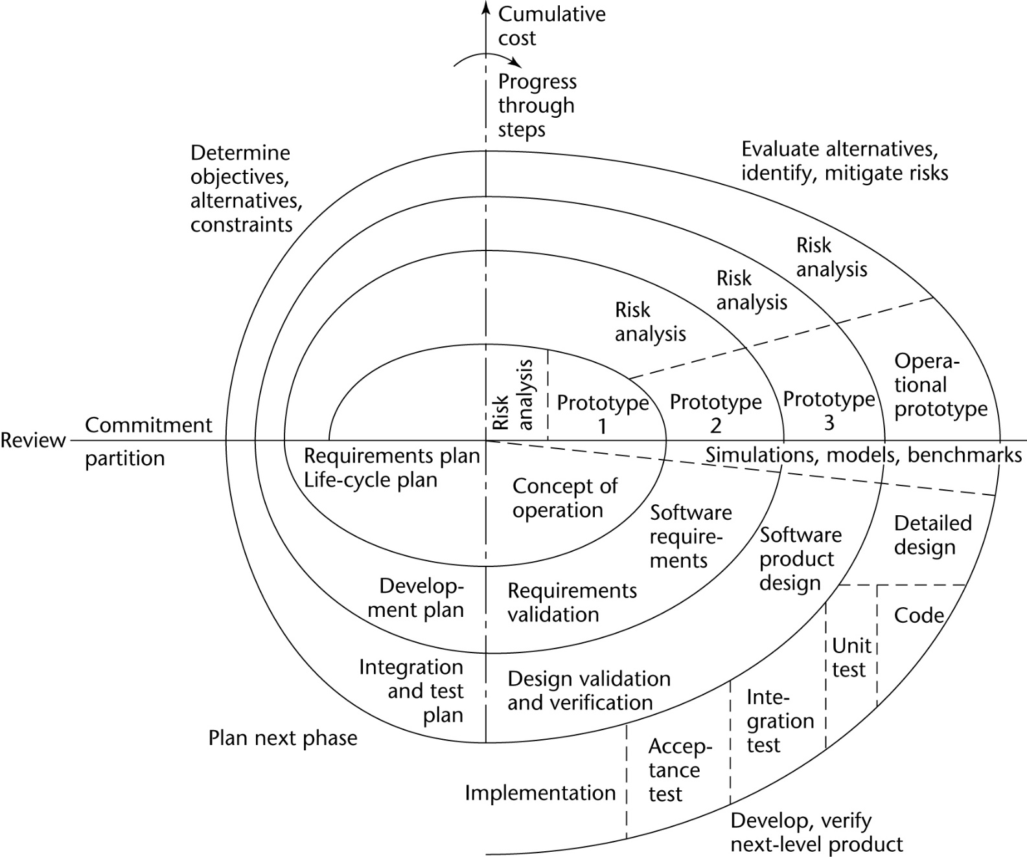
1986: Spiral model
Notes:
Originally proposed by Barry Boehm (pronounced baym) in 1986, Spiral and its descendants are still in wide use today. Boehm calls Spiral a meta-model rather than a model, as the detail to which successive activities are to be defined is to be determined during risk analysis in order to minimize aggregate risk – therefore, if the requirements are vague, Spiral behaves similarly to Agile; if the requirements and software domain are well-known and there is enough time for thorough documentation, it behaves like Waterfall. However, it is open to question whether most software engineering professionals share Boehm’s vision for Spiral.

Slide 24
1986: Spiral model
Start here
Notes:
Start in the middle and work outwards. Each turn around the spiral is an iteration. In each iteration, you should
take stock of the current state of the project and what your options are for the next iteration
perform risk analysis to identify where effort/resources should be targeted – objective is to minimize risk
build a prototype or model
validate the prototype or model
plan the next phase (if any)

Slide 25
1986: Spiral model
Risk Analysis

Slide 26
1986: Spiral model
Prototype

Slide 27
1986: Spiral model
Build and validate

Slide 28
1986: Spiral model
Plan

Slide 29
2001: Agile family of processes
A group of seventeen like-minded software engineers met at the Snowbird resort in Utah
Shared interest in so-called lightweight process models that deemphasized document-driven software construction
Not a single process model, but rather a set of core values
These values are expressed in the Agile Manifesto
you can read all about that in this week’s compulsory reading!
Notes:
Students who have taken FIT2099 or FIT3077 should recognize at least some of the attendees: Martin Fowler, Kent Beck, Alistair Cockburn, Ward Cunningham, Robert C. Martin.

Slide 30
Software process models and risk
All software processes are an attempt to mitigate risks
we follow them because they make it more likely that we will ship on time, on budget, and to spec
Different software processes represent different attitudes to risk
especially the risk of change to requirements
Waterfall: define requirements stringently to eliminate change
Spiral: periodically review requirements and risks to manage change
Agile: involve customer in development and embrace change
Risk is a very important concept in this unit and we will revisit it in more detail later in the unit
For now, we’re going to talk more about Agile process models
general background in this week’s Moodle readings
next week: Scrum

Slide 31
Next week
Scrum

